Slide 1

CLIQUE – Experience Luxury At Convenience

Slide 2








WAIŪ : Mission, Vision & Values
Mission:
To create a global service provider of hospitality industry, realizing pioneering advancements in established services and accomplish mutual growth for both our partners & customers
Vision:
WAIŪ is dedicated to provide modern & innovative solutions to our hospitality partners, via introduction of technology evolution in their offerings and creating avenues of inspiring new business horizons.
Values:
Innovation through Leadership : To become vanguard of hospitality experience enrichment
Modernization & Elegance : To develop ultramodern hospitality business solutions
Focus & Evolution : Relentlessly strive to improve business value through performance

Slide 3



Clique – The Opportunity under WAIŪ Umbrella
Clique is premium service offered to our finest customers & business partners, to mutually benefit through means of microfinancing services.
Clique will be a unique solution focused on hospitality industry, that has been consistently growing & creating pristine opportunities for restaurants & its ever-growing youthful consumer base.
Clique is designed to promote inclusive growth in hospitality industry by introducing flexible borrowing as channel partners, while simultaneously allowing ease of doing business and comfortable provisions.
With microfinance market anticipated to grow with CAGR of 40% through 2025, NBFC-MFIs will be its greatest beneficiaries. In F&B segment, unbanked microlending has only reached 12-15% of the prospective market.

Slide 4
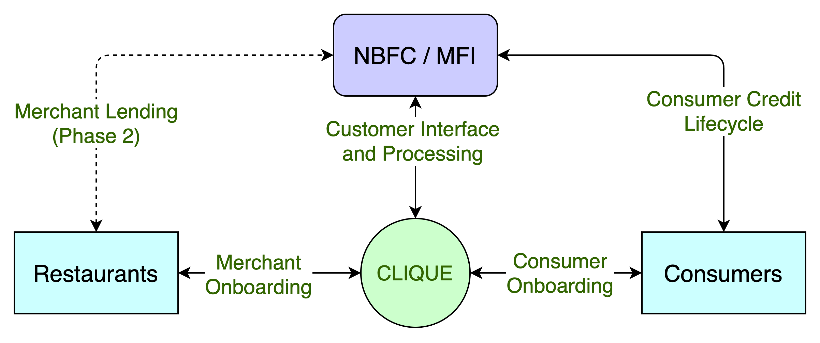
Clique – High Level System Flow
CASE STUDIES
Zomato, in partnership with InCred, to lend Rs 1L to 50k restaurants, developing loan book of 500CR
PAYO (Australia) – Launched ENPL service in July-21 & already has 500+ restaurant partners

Slide 5
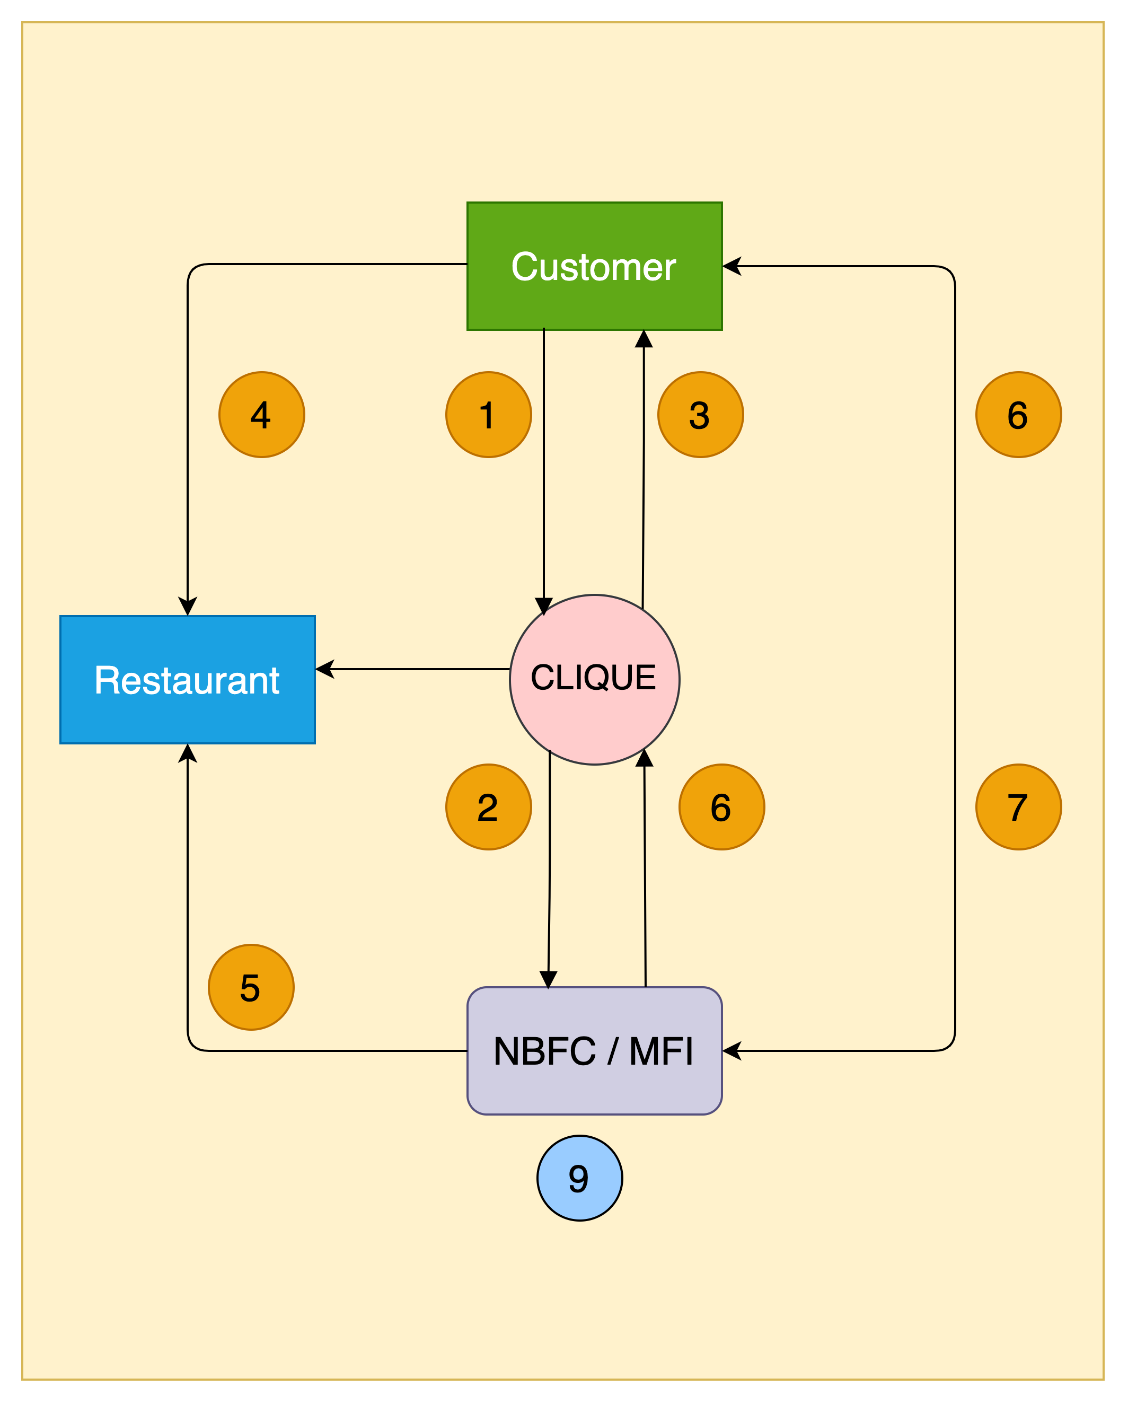
Clique – High Level Transaction Process Flow
1. Customer walks into a restaurant & applies for the wallet credit through Clique App
2. Clique receives customer application & send it to the lender for underwriting & respond with approval or rejection
3. Customer app wallet is credited with approved funds & signs NACH mandate
4. Customer utilises the wallet credit at the restaurant e.g., Rs 5000
5. Lender pays the merchant (less the operational charges) based on merchant's billing cycle e.g., Rs 4000
6. Lender pay the commission to Clique e.g., Rs 800 based on payment reconciliation, on agreed frequency
7. Customer pays lender later based on agreed T&C,
including interests, delay charges etc.
8. Once paid, even if partially, lender updates Clique to reset
customer’s wallet for calculated funds for further utilisation
9. Lender keeps the balance i.e., Rs 200, for their services

Slide 6
Clique – Customer Onboarding Journey
02
Customer reviews standees, flyers, tent cards and informed by staff about Clique
03
Customer downloads Clique app and completes KYC application
01
Customer walks into
a restaurant
Clique routes the application to lender
06
Lender sends a confirmation back to Clique
04
05
Lender underwrites the customer
07
Clique updates customer app and reflects the wallet credits
08
Customer enjoys the F&B services
09
Customer pays through clique credit & returns home

Slide 7
Clique – 360° Benefits
Eat now, Pay Later
Consumers | Restaurants | MFI-NBFC
Increase in spend potential | Increased sales | New customers
Bio-authorization to reduce risks | Higher ticket size | Increased presence
No joining or renewal fees | New feature to offer | Competitive edge
Decorum & savings | No additional charges | Innovative offer
Microfinancing
Consumers | Restaurants | MFI-NBFC
Increased borrowing potential | Self-sufficiency at competitive rates | Untapped market – Millennials, Zoomers
Enhanced financial literacy | Standardized & organized system | Inclusive growth
Reactive credit scoring | Reduced regulatory challenges | Valued partnership
Better rates than banks | Co-branding opportunities | Benefit from geographic expansions

Slide 8







PAYO (Australia) – A case study
About PAYO
PAYO is an Australian company who have launched the world’s first Eat Now, Pay Later service in July 2021.
The are backed by an existing lender with substantial customer base in the operational regions.
Being the World’s first ENPL app, they have favorably placed themselves as market disrupters, driving investor’s interest & confidence.
Within 3 months of launch, 700+ merchants in 4 cities & growing at the pace of 200 merchants every month
All payments are divided across 4 interest free EMIs, with only a quarter of payment to be made upfront.
Top performing 50 restaurants have received thousands of transactions with recorded order value increase of 60%
Diners can discover restaurants, filter by preferences, call restaurant, book table and receive range of offers & deals.
Both restaurants & customers are incentivized for referring more paying users to the platform
All payments are via PAYO app via QR codes with options for customer to recommend for PAYO business
Instant approval & discreet process has given PAYO an edge over other modes of payments, eliminating need to carry wallets

Slide 9
Customer Acquisition Strategy
Merchant Acquisition Strategy | Consumer Acquisition Strategy | Notes
Direct sales via dedicated regional teams (10 per location per month) | WAIU direct acquisition (6-8k per location per month) | WAIU service acquisitions
Corporate collaborations with multi-location hospitality brands | Aggregation based model to increase time to market | To enable increased time to market
Pre/Post launch promotional & marketing campaigns | Social media & network advertisements | Combination of digital & traditional strategies
Network tie-ups and contact center for customer servicing | Event tie-ups e.g., Ridermania, Ruggedian

Slide 10
Case Studies
Company / Particular | Dineout | Magicpin | Eazydiner | Devourin
Founded | 2012, Noida | 2015, Gurgaon | 2014, Delhi | 2015, Pune
Owner | Times | Self | Self | Self
Services | Booking, Rewards, Payments, Artists | Discovery, Rewards | Discovery, Payment, Rewards | POS, SCM, Data Analytics, CRM
Coverage | 20 Cities | 40 Cities | 150 Cities | 2 Cities
Acquisition Restaurant / Customers | 50K / 2.5CR | 1.5L / 50L | 10K / 30L | 200 / None
Investments | $100MN (2019) | $43M (2021) | $16M (2020) | $150K (2016)
Revenue | $200M | $10M | $42M | $500K
YoY Growth | 154% (2019) | 415% (2018) | 400% (2019) | TBC
Valuation | TBC | $165M | $40M | $1M

Slide 11
Project Plan – 6 Phased
Phase 06
Q3 2024
Expand in existing 7 Cities & explore additional scope
Target 2400 Restaurants & 3 Lacs Customers per city
3600 FL3
36Lacs FL4
3000 FL3
30 Lacs FL4
Phase 05
Q1 2024
Expand in existing 7 Cities & explore additional scope
Target 2000 Restaurants & 1.5 Lacs Customers per city
Phase 04
Q3 2023
Expand in existing 7 Cities & explore additional scope
Target 1600 Restaurants & 75K Customers per city
2400 FL3
24 Lacs FL4
1800 FL3
18 Lacs FL4
Phase 03
Q1 2023
Expand in existing 7 Cities & explore additional scope
Target 1200 Restaurants & 25K Customers per city
Phase 02
Q3 2022
Expand in existing 7 Cities & explore additional scope
Target 800 Restaurants & 10k Customers per city
1200 FL3
12Lacs FL4
Phase 01
Q1 2022
Launch in 7 Cities
Target 400 Restaurants & 1200 Customers per city
Company Registration : July 2020 - Complete
MVP PoC : Dec 2021
Foundation Period : Q1 2022
Launch : Q1 2022

Slide 12
Our Team – In-Progress
Rajesh Karandikar – Founder & Owner, Hotel 24K Restaurant Network
Alok Sambuddha – Engineering Director, American Express (ex. Technology Leader – Infosys, ATOS)
Rahul Renavikar – Managing Director, Acuris Advisors (GST & Government Policies) – Ex. Big 4 & Tata Motors
Suhas Gokhale – Managing Director, COSMOS Bank, Pune
Shrikant Chatur – Governance Consultant (ex. VP Commercial - Cummins)
Shrikant Chepe – Technical Architect (Amway Head of Customer Solutions)
Rahul Patil – Security Specialist (Mastercard)
Chetan Oswal – Accounts & Legal Counsel
Partners:
IRSRD – Development, Governance, Technical Consultant, HR
KPMG – PPI Procurement Partner & Project Management
Sazinga Digital – Current Development Partner (Discussions ongoing with prominent vendors)

Slide 13






Question & Answers

